Slide 1
Keylogger and security
CAPSTONE PROJECT
Presented By:
M. DIVYASREE - Priyadarshini Engineering College - CSE

Slide 2
OUTLINE
Problem Statement
Proposed System/Solution
System Development Approach
Algorithm & Deployment
Result (Output Image)
Conclusion
Future Scope
References

Slide 3
Problem Statement
It's challenging to covertly install a hardware keylogger on another person's device. To tackle this issue, We are therefore using a software keylogger that can be remotely installed on a person's PC to resolve this problem. Keyloggers are dangerous because they steal personal information, passwords, and sensitive data right from under your fingertips.

Slide 4
Proposed Solution
Maintaining good cyber hygiene and following online safety best practices can help you stay safe from keylogging. While no solution is entirely foolproof, taking these steps can help reduce your risk of malware and prevent keylogging threats.
Two-Factor Authentication
Two-factor or multi-factor authentication provides an effective defense against keylogging viruses and malware. Two-factor identification adds an additional step when logging into an account or device, requiring a temporary PIN or fingerprint to verify that you own the account you’re logging into. If your passwords are identified via keylogging, two-factor authentication will keep cybercriminals from accessing your accounts remotely.
Only Download Safe Files
Avoid downloading files from unsafe websites or clicking links in an email from an unknown sender. Phishing has become more sophisticated, so you should be cautious of clicking links or downloading attachments from people you know, as their email or other accounts may have been hacked.
Install Antivirus Software
Many antivirus software options now include anti-keylogger and anti-spyware protection. This software can help you identify and avoid keylogging malware. Installing and keeping antivirus software up-to-date prevents having your information stolen.
Use a Password Manager
A password manager is a convenient way to avoid forgetting passwords and they’re also a great way to prevent keylogging attacks. By using a password manager, you won’t display your passwords on a screen or physically type them.
Although keylogger malware relies on stealth, it may show warning signs like slower computer performance or unusually low storage space. Understanding how keylogging works can help you detect and remove keylogging malware.

Slide 5
System Approach
A software keylogger is put on a computer when the user downloads an infected application. Once installed, the keylogger monitors the keystrokes on the operating system you are using, checking the paths each keystroke goes through. In this way, a software keylogger can keep track of your keystrokes and record each one.
1. Existing System : The keylogger already exist just record the keystroke in the same system and the the program has to be install manually and retrieve the keystroke manually form the target machine . which is not so easy to get access to target machine to run the keylogger program in that and get access to the target machine and access the program later and get the keystrokes.
2. Proposed System : In this program I have reduced the work of accessing the target machine after installing the program to get the keystrokes stored in the target machine because I have enabled an option for the user to get the keystrokes from the target machine using mail. The program automatically stores the keystrokes and mail to the user from the target machine which makes the work for the user to avoid going to the target machine again and retrieve the data.

Slide 6
Algorithm & Deployment
ALGORITHM:
1. Initialization: Initialize variables and setup necessary configurations.
2. Start Keylogger:
- Create a keyboard listener using the `pynput` library.
- Define functions to handle key press and release events (`on_press` and `on_release`).
- Start the keyboard listener to capture keystrokes in real-time.
3. Capture Keystrokes:
- Upon key press event, append the pressed key information to the `keys_used` list.
- If a key is held down, continuously append the held key information until it is released.
- Upon key release event, append the released key information to the `keys_used` list.

Slide 7
Algorithm & Deployment
4. Logging:
- Implement functions (`generate_text_log` and `generate_json_file`) to log captured keystrokes into text and JSON files, respectively.
- Ensure secure and consistent storage of keystrokes locally on the system.
5. User Interface:
- Develop a simple GUI using `tkinter` with buttons to start and stop the keylogger.
- Configure button callbacks to initiate and terminate the keylogging process.

Slide 8
Algorithm & Deployment
DEPLOYMENT:
a. The program will wait for all the system processes to initialize.
b. The keylogger daemon is initialized and the process will be gauged in scale of time.
c. A log file is created for the current session to log all the keystrokes and maintain a record.
d. If no event occurs, keylogger continues listening to the strokes.
e. If an event occurs, the keylogger classifies the type of keystroke that has occurred- special key which are commands or normal text input.
f. If a special key that gives a command has been entered then it is compared with a value in a dictionary and recorded in the log file.
g. If a normal text i.e. anything in the range of ASCII characters has been inputted, the ASCII code is converted to its respective character and this is exported to the log file.
h. The inputs along with their timestamps are recorded in the log file.

Slide 9
Algorithm & Deployment
DETECTION:
a. The program checks if there has been any delay in normal registering of keystrokes.
b. If there is no delay then exit. If there is a delay then go to step 3.
c. Import the list of all the startup processes and monitor them for memory usage.
d. Simulate pseudo-random keywords and observe the resource usage within the processes.
e. If any processes have irrelevant memory usage, they are removed for e.g. system processes, user processes are kept and monitored.
f. Input pre-determined strings and obtain memory values.
g. If the same increment patterns are observed go to step 8, else go to step 5.
h. The process is flagged as a keylogger and exit.

Slide 10
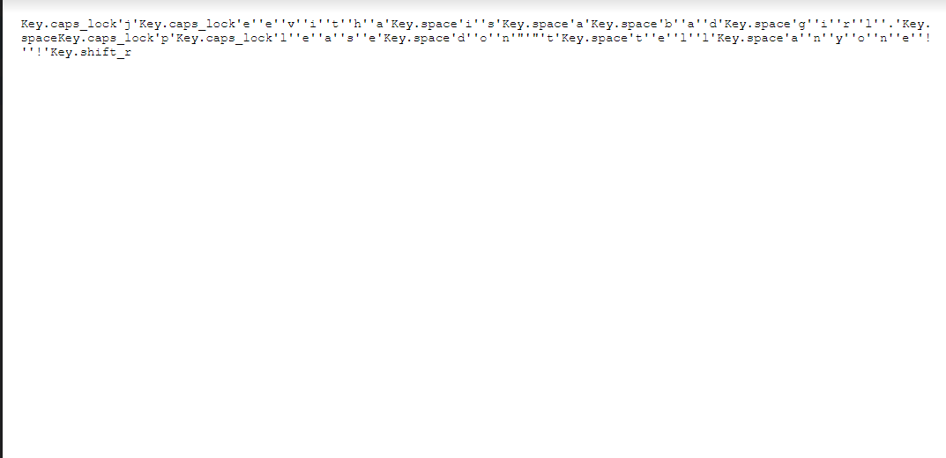
Result
Keylogger is running and key_log.txt is generated:

Slide 11
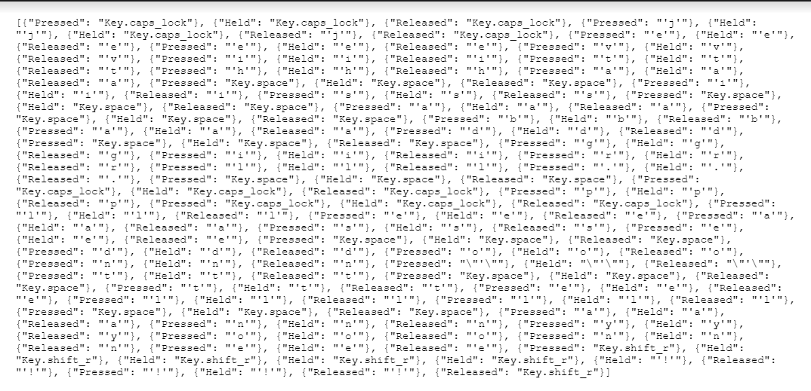
Result
The generated Key_log.txt with the keystrokes recorded:

Slide 12
Security Measures:
1. Use Security Software: Install reputable antivirus and anti-malware software that can help detect and prevent keyloggers. Or, outsource your security via a managed detection and response provider.
2. Keep Software Updated: Regularly update your operating system, applications, and security software to patch vulnerabilities that attackers might exploit.
3. Use Common Sense. Avoid downloading files or clicking on links from unknown sources. Be cautious when opening email attachments, especially if they're from unfamiliar senders.
4. Use Virtual Keyboards: Some security-sensitive activities (like entering passwords) can be done using virtual keyboards, which can help thwart keyloggers that are designed to capture physical keystrokes.
5. Regular Security Scans: Perform regular malware scans on your computer to identify and remove any potential threats.
6. Don’t Forget Physical Security: Be aware of physical security risks, especially in public places. Check your surroundings for suspicious devices attached to the computer or keyboard.

Slide 13
Conclusion
We have thus designed a system to deploy and detect a keylogger. This system is not perfect by any stretch and we aim to better it as time goes on. We aim to make this system more user-friendly and interactive. There are multiple ways of capturing keystrokes since all a keylogger needs is to sit between processes and record it and there are multiple ways to detect a keylogger, there is no single, perfect way of detection. We need to be with the times and ahead of a malicious user. And also for searching in RAM will be easier if we use any searching mechanism or string matching program. The goal was to create a method for keylogger detection and make it easier for non-technical person. This proposed method does not need any special technical knowledge. Any regular person will be able to handle it.

Slide 14
Privilege escalation mitigations (Running keylogger in non-admin mode to avoid privilege exploitation)
Using UTF-8 Unicode characters instead of ASCII (UTF-8 will provide a higher scope for character detection)
Optimizing heuristic operation of keylogger (Optimizing RAM usage so that the keylogger uses low RAM and becomes difficult to get noticed
Future scope

Slide 15
Future scope
Furthermore, ensuring secure data transmission mechanisms is paramount for maintaining the confidentiality and integrity of captured keystrokes. By enhancing the keylogger to securely transmit data to a remote server or monitoring system, centralized logging and analysis can be facilitated while mitigating the risk of unauthorized access or tampering.
Integration with security management systems can also enhance the keylogger's capabilities by correlating keystroke data with other security events and logs. This comprehensive approach provides a holistic view of security incidents, enabling proactive threat detection and response strategies to be implemented effectively.
Overall, by pursuing these avenues for development and improvement, the keylogger project can evolve into a more robust and sophisticated tool for enhancing cybersecurity measures and safeguarding sensitive information..

Slide 16
References
Python Documentation:
- Website: https://docs.python.org/3/
- Python's official documentation provides comprehensive information on the Python programming language, including tutorials, guides, and references for various modules and libraries used in the project.
Tkinter Documentation:
- Website: https://docs.python.org/3/library/tkinter.html
- Tkinter is Python's standard GUI (Graphical User Interface) toolkit. The documentation offers detailed explanations, examples, and references for building GUI applications using Tkinter.
Pynput Documentation:
- Website: https://pynput.readthedocs.io/en/latest/
- Pynput is a Python library used for controlling and monitoring input devices such as keyboards and mice. The documentation provides guidance on how to capture keystrokes and handle input events using Pynput.

Slide 17
References
JSON Documentation:
- Website: https://docs.python.org/3/library/json.html
- JSON (JavaScript Object Notation) is a lightweight data-interchange format commonly used for storing and transmitting data. The Python documentation offers guidance on working with JSON data, including parsing, encoding, and decoding operations.
Cybersecurity Resources:
- OWASP Website: https://owasp.org/
-This provide valuable resources, guidelines, and best practices for enhancing cybersecurity and addressing security concerns in software development projects.

Slide 18
THANK YOU

